Slide 1


Competition Law, Online Markets and Offline Welfare Effects
Riga, 20 October 2017
The Latvian Law Institute,
The Riga Latvian Society House
Ariel Ezrachi
Slaughter and May Professor of Competition Law, Oxford University
Director, Oxford Centre for Competition Law and Policy

Slide 2
The Dynamics of Competition
The Promise of the Algorithm-Driven Economy
  Transparency and flow of information
  Lower Search Costs
  Dynamic competition
  Entry and Expansion
  Dynamic pricing
  Disruption and Efficiencies
  The Rise of Big Data and Big Analytics

Slide 3
The Perils of the Algorithm-Driven Economy
Competition, as we know it -- the invisible hand -- is being displaced by a digitalized hand.
  Collusion – Algorithms as cartel facilitators.
  Discrimination
  Market power

Slide 4
Digitalised Collusion
‘Classic’ collusion
  Airline Tariff Publishing
  Topkins
  Trod
Hub and Spoke
  Intentional and unintentional alignment of price.
  Eturas and Others
  Dynamic personalised pricing - example: Gas stations in the Rotterdam area using the same a2i Systems pricing software...

Slide 5
Responsibility of provider? Cartel facilitators
Case T-99/04 - AC-Treuhand AG v Commission (AC-Treuhand I)
An undertaking may be responsible for the implementation of the anticompetitive activity even if it does not restrict its own freedom of action on the market on which it is primarily active.
Case C-194/14 - AC-Treuhand AG v Commission (AC-Treuhand II)
In the present case AC‑Treuhand played an essential role in the infringements at issue by organising a meetings and actively participating in them, by collecting and supplying data on sales on the relevant markets and by offering to act as a moderator. The action taken by AC‑Treuhand did not constitute mere peripheral services but were directly linked to the antic-competitive efforts made by the producers of heat stabilisers.

Slide 6
Case COMP/E-2/37.857– Organic Peroxides
‘AC Treuhand is a Zurich based entity providing, amongst other things, services such as collecting statistics to enterprises...’
organised meetings;
produced, distributed and recollected the so called ‘pink’ and ‘red’ papers with the agreed market shares;
calculated the deviations from the agreed market shares,
reimbursed the travel expenses of the participants, in order to avoid traces of these meetings in the companies’ accounts;
collected data on OP sales and provided the participants with the relevant statistics;
stored the original agreement;
acted as a moderator
was actively involved in reshaping the arrangement among producers
advised the parties whether or not to allow other participants into the agreement;
instructed all participants on the legal dangers of parts of these meetings and on what measures to take to avoid detection of these arrangements' bearing on Europe;…

Slide 7
Chemical Industry EC Cartel Cases since 1966
where given firm has been named in 3 or more decisions
Firm | Number of cartels | Full Leniency
Akzo Nobel | 9 | 4
Fides/AC Treuhand | 9
BASF | 7
Bayer | 7 | 2
Solvay | 7
Shell | 6 | 1
Degussa | 6 | 2
Hoechst | 6
Arkema/ Atofina | 6
Rhone Poulenc/Aventis | 5 | 2
ICI | 5
Elf Aquitaine | 5
Atochem | 4
ADM | 3
Dow | 3
Enichem | 3
Repsol | 3
Source: Robert C. Marshall ‘Unobserved Collusion: Warning Signs and Concerns’ Journal of Antitrust Enforcement

Slide 8
Tacit Collusion on Steroids
  May be relevant in narrow concentrated markets with entry barriers, homogeneous products, no brand recognition or loyalty.
  ‘Simple’ algorithm-stabilising-mechanism
  Transparency | Stability | Speed | Wider participation.
  Consider increased use of algorithm and increased market concentration.

Slide 9
Behavioural Discrimination
Controlled Ecosystems: The Truman Show
Friction and outside options.
Minimize the Perceived Unfairness through Framing Effects
Daniel Graf, Uber’s head of product – “The company applies machine-learning techniques to estimate how much groups of customers are willing to shell out for a ride.” (2017 Bloomberg)
Facebook & emotional bias. …”moments when young people need a confidence boost.”…" "insecure," "defeated," "anxious," "silly," "useless," "stupid," "overwhelmed," "stressed," and "a failure."

Slide 10


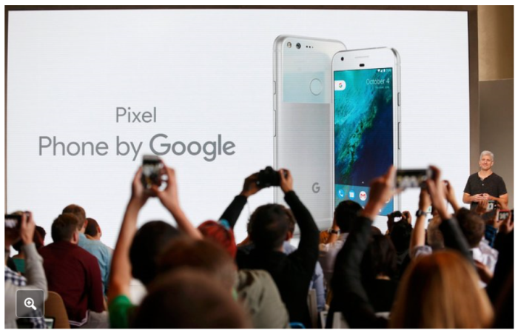

The Digital Butler

Slide 11
Market power
The Gatekeepers
The rise of super platforms and how Data-Opolies can abuse their position.
Multi-home?
Obligation to favour competing services?

Slide 12
Google (Alphabet)
Google I - 2.4 Billion fine - Abusing of search dominance to favour of its own comparison-shopping websites.
Google II - Bundling practices related to Google's Android mobile operating system
Google III - Adwords - online advertising service.

Slide 13
Google - background
Leveraging market power from search engine to its comparison shopping service.
Prominent placement to its own service and demoted others.
Commission analysed click behaviour, and simulated change positioning:
  ‘even the most highly ranked rival appears only on page 4’
  ‘others appear even further down’
  Demotion results in immediate drop of 90% of clicks.
  95% of users click on first page.
  Simulation - Moving first result to third rank, results in reduction of clicks by 50%. Same result receives significant more traffic when ranked up’
  This tendency even higher on mobile devices.

Slide 14
Pay with Data
Not a free market
The Commission states that ‘Consumers pay for the service with data’
FTC Staff Report re Google Inc found, “Although a user does not pay for the web search service, the user’s focused interest - or intent - is very valuable to advertisers, because users arc effectively identifying themselves as potential customers through the content of their queries.”

Slide 15
Google - Market definition
Upstream - General Internet Search
Downstream – shopping comparison aggregators.
  Market does not include brick and mortar, nor other search engines.
  Likely defined with reference to the platform.
One market or two? Leveraging theory or single vertically integrated product?
Insignificance of ‘comparison shopping services’
  Google Shopping, Shopzilla, PriceGrabber, Amazon Product Ads, eBay Commerce Network, Become, Nextag, Bing Product Ads

Slide 16
Market power
Google: ‘people have more choice than ever before”
Commission: ‘Google dominates each national market for search’
  High barriers to entry.
  Network effects –
  Direct network effects - More users, better results
  Indirect network effects - more users, more advertising income.

Slide 17
Network effects
Trial-and-Error - the scale of search inquiries processed by the search engine.
  ‘The accumulation of data can lead to significant improvements of data-driven services which in turns can attract more users, leading to even more data that can be collected. This “positive feedback makes the strong get stronger and the weak get weaker, leading to extreme outcomes” (Shapiro and Varian, 1999).’ (OECD)
Scope of Data
Spill-overs and Snowball Effect
  ‘The reuse of data generates huge returns to scale and scope which lead to positive feedback loops in favour of the business on one side of the market, which in turn reinforces success in the other side(s) of the market.’ (OECD)

Slide 18
Google – Theory of harm
Reduce competition downstream.
Push out as efficient competitors.
Ability to switch does not equal incentive to switch.
  Consider impulse purchase as analogy – despite no formal lock-in, de facto power.
Do customers multi-home? Do they care?
If customers do not care, should we care?
‘Competitors may be a click away, but competition isn’t.’ (Comment by Andreas Mundt)

Slide 19
Abuse
Exclusionary, rather than exploitative.
Vertically integrated company cannot favour its own downstream services.
No requirement for indispensability of platform [?]
What might be the impact on vertically integrated companies?
Objective justification?
Can this be viewed as
product improvement?
Direct access to comparison results?
Balancing exercise?...

Slide 20
Quality degradation
… not of organic search results, but of overall placement ...
‘Google's commercial product is not subject to the same algorithms as other comparison shopping service’ Users do not “necessarily see the most relevant comparison shopping results in response to their queries, and that incentives to innovate from rivals are lowered as they know that however good their product, they will not benefit from the same prominence as Google's product.” (SO press release)

Slide 21
Incentives to downgrade
Assuming users will not switch, a carful downgrade could -
Improve position of own services downstream.
Blur distinction between sponsored and organic results.
“hold-up” scenario
Possible effects:
higher prices (due to higher advertising costs),
higher search costs (in having to spend more time to find the relevant result),
less relevant results (when under the hold-up scenario companies refuse to advertise),
less innovation (when companies know that however good their products or services, they will be unable to effectively reach consumers online).
Is it possible that what competition agency views as downgrade is neutral as far as users are concerned?

Slide 22
‘The degradation of organic search could possibly be achieved through various means. For example, platforms might have an incentive to dedicate a smaller part of the result page to organic results in favour of search advertising links (also called sponsored links) thereby providing proportionally more advertising links. Alternatively, the platforms may rank the sponsored and organic search results in a way that firms offering competing products to the sponsored links are ranked, from the user's perspective, on the organic side lower than optimally.’
Microsoft/Yahoo investigation, EU Commission

Slide 23
Google – Consequences
‘It has to give equal treatment to rival comparison shopping services and to its own’
‘It has to apply the same methods and processes to position and display its own and rival … services’
‘Google cannot simply stop doing what it is doing and replace it with other practices that have the same or equivalent anti competitive effect.’

Slide 24
Other gatekeeper effects -
The Dynamic Interplay Among Frenemies
Extraction and Capture
A Tale of Two Apps

Slide 25
Bundeskartellamt - Facebook & Privacy
Facebook has abused its market power in the market for social networks.
Users ‘forced’ to agree to terms and conditions which ‘feed’ the data machine.
‘The fear of social isolation is exploited to get access to complete surfing activities of users’
‘Privacy is a competition issue’ … ‘if non acceptance results in refused service’ (AM)
Is competition law the optimal vehicle to for privacy protection ?

Slide 26
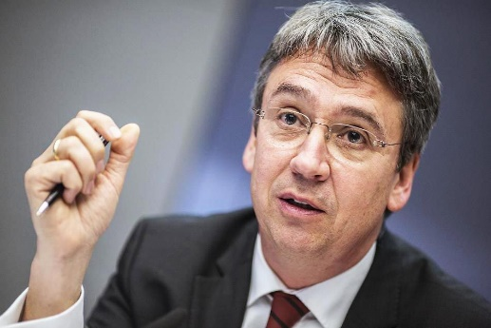
View from Germany - Andreas Mundt
Market is dynamic and consumers have choice, yet characterised by a small number of companies with concentrated power.
‘Ordoliberal vision – struggle for market share - is gone, we have monopoly and oligopoly’
2004 – Last time a super platform was disrupted when myspace was replaced by Facebook .
Doubt that competition is a click away. ‘The consumer does not sit in front of the screen looking for terms and conditions and considering all options.’
Abuse of dominance becomes the main channel.
Digital butlers may foreclose markets.
Regulation is slow and static -
Competition enforcement is the
better instrument.
www.competition-law.ox.ac.uk

Slide 27
Changes to German Competition Law
8th and 9th Amendments to the German Act against Restraints of Competition:
  Access to data is a competition parameter
  Direct and indirect network effects are relevant parameters
  Free services may constitute a market for the purpose of analysis.
  Presumes a dominant market position for market shares of 40% and up. (8th, 2013)
New transaction-value-threshold for mergers (400 million)

Slide 28
‘Wide approach’ to address digital challenges?
Could fairness serve as an intervention benchmark?
Andreas Mundt: Facebook's case centres on the questions relating to the current fair competition in the digital landscape.
Japan: Competition law promotes ‘fair and free competition’
South Korea: ‘promoting the balanced development of the national economy by encouraging fair and free competition’
Taiwan: ‘protect consumers’ interests, ensure fair competition’
EU – Fairness is part of effective competition. Promotes ‘fair share of efficiencies’ (101 TFEU) and condemns ‘unfair prices’ (102 TFUE)
AG Lynch: The DOJ is ‘committed to fair, open and competitive markets’ and noted the significant role of ‘economic justice.’

Slide 29
Media and the market for ideas
Giant players
Platforms - The power to set standards, rank, make and break connections, favour own operations.
Media organisations – The power to influence public opinion and regulation.
Monopolistic competition,...
Market for ideas
Ability to influence composition of reports and news stories.
Ability to offer diverse news to individuals.
Filter bubble & personalized searches
Impact
Increased engagement by young adults.
De-centralised market.
Risk of fake and sponsored news.
Long term concerns
Increased concentration - Economic power → Political power
Gatekeepers and over blocking.
Buyer power and the impact on news organisation.
Impact on democracy.

Slide 30
Intervention?
Careful balancing exercise.
Competition law one of many instruments.
Wide tool box - data protection, privacy…
Against intervention
The formidable market forces will fix it,…
Disruptive innovation may change it all,…
Clear chilling effect.
Call for intervention
‘Competition is for losers’.
Network effects, interconnectivity & deep pockets,….
Cost of under enforcement.

Slide 31
The goals of competition law
Total Welfare,… Consumer welfare,… Efficiency,… Competitive process,… Market structure,… Fairness,… Wealth distribution,... Industrial policies,…
‘Narrow’ view
Purity of antitrust should not be undermined.
Only what we can count, counts.
No link between concentration and harmful effect,…
‘Wide’ view
Social policy.
Consumers at the heart of the analysis.
Fairness,…

Slide 32
Final Reflections
To what extent does the “invisible hand” still hold sway?
Does Virtual Competition call for a new approach or is it merely ‘old wine in new bottle’?
Be mindful of the risks and costs of over and under intervention.
What is the impact on the market for goods and services?
What is the impact on the market for ideas? democracy? autonomy?

